Slide 1
Reducing the chattering problem in Sliding Mode Control (SMC) by using a Deep Neural Network (DNN) in torque vectoring
2023. 12. 06
SMEET LAB

Slide 2
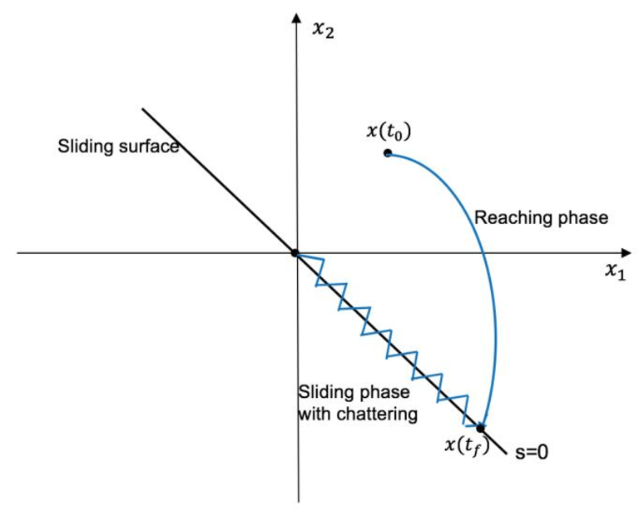

Sliding Mode Control(SMC)
What is Sliding Model Control
SMC is a nonlinear control approach which use relay as the basic control element
The main purpose of SMC is to ensure system stability and robustness against uncertainties and external disturbances
$u=u_{eq} −K∗sign(σ)$

Slide 3
Sliding Mode Control(SMC)
Advantages of SMC
Robustness
System stability
Simplicity and Ease of Implementation
Nonlinear Control
Disadvantages of SMC
Chattering

Slide 4
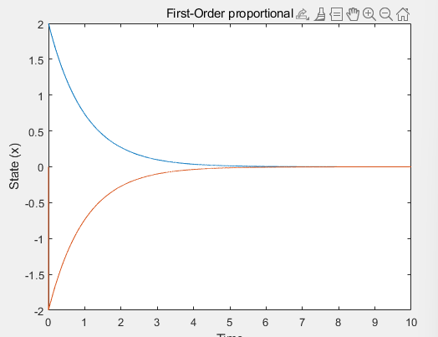
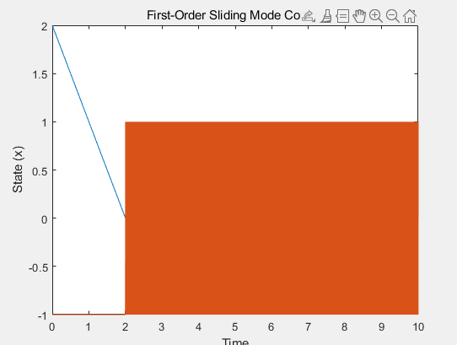
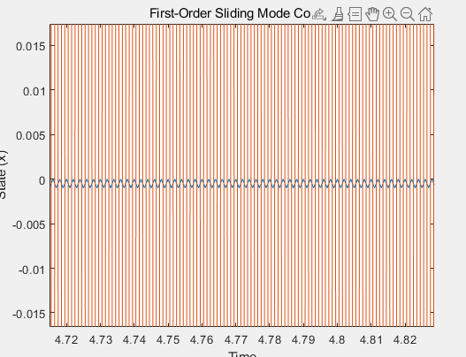

Sliding Mode Control(SMC)
Example of the First order SMC
$\dot{x}=u$
Proportional control : u =-k(x-x_desired), SMC = u=-Ksing(x-x_desired) ; K is gain

Slide 5
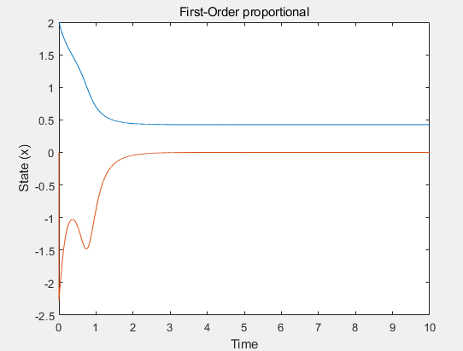
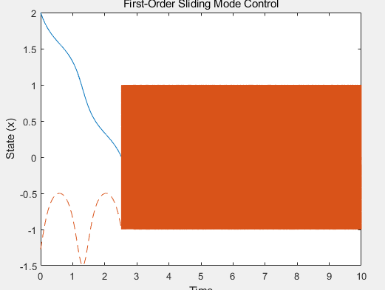
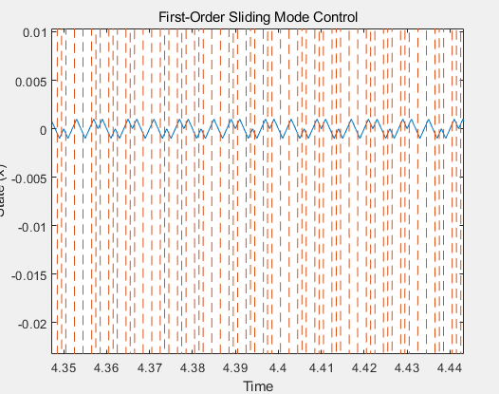

Sliding Mode Control(SMC)
Example of the First order SMC
$\dot{x}=u$ +d(disturbance)
disturbance d = 0.5*sin(5t)

Slide 6
Other Modern Control
Model predictive Control (MPC)
Purpose : MPC uses a model of the process to predict the future behavior of the system. It optimizes control actions at each step based on a set of constraints and a cost function over a future prediction horizon
Advantage : can handle multi-variable control problem, Flexible in adapting to changing system condition
Disadvantage : Performance heavily relies on the accuracy of the model, and requires significant computational resources

Slide 7
Other Modern Control
Linear Quadratic Regulator (LQR) Control
Purpose: LQ control is aimed at minimizing a quadratic cost function, which typically includes terms for error and control effort. It is used mainly for linear systems.
Advantage : Efficient for linear system, Easy to make
Disadvantage : Linear system only, not robust

Slide 8
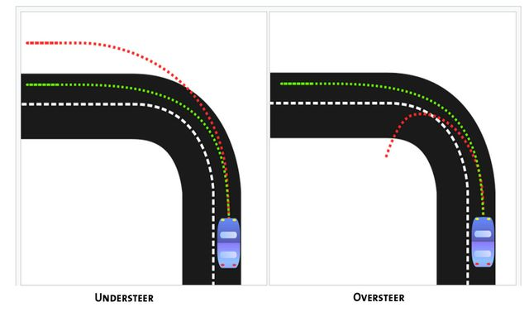
Torque Vectoring
What is Torque Vectoring
Torque Vectoring is distributing power individually to make extra yaw moment
This extra momentum improve handling, stability and performance

Slide 9
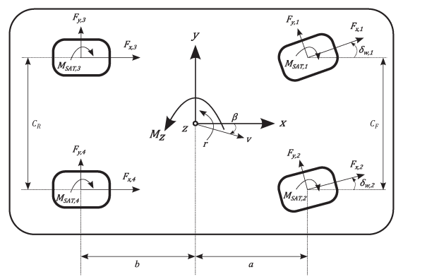

Torque Vectoring
Vehicle yaw momentum equation
$J_{z}\dot{r}=\left(−F_{y,2}sinδ_{w,2}+F_{y,1}sinδ_{w,1}+F_{x,2}cosδ_{w,2}−F_{x,1}cosδ_{w,1}\right)\frac{C_{F}}{2}+\left(−F_{y,2}cosδ_{w,2}+F_{y,1}cosδ_{w,1}+F_{x,2}sinδ_{w,2}+F_{x,1}sinδ_{w,1}\right)a−\left(F_{y,4}+F_{y,3}\right)b+\left(F_{x,4}−F_{x,3}\right)\frac{C_{R}}{2}−M_{SAT,1}−M_{SAT,2}$- $M_{SAT,2}$- $M_{SAT,4}$
Control Value : $M_{z,F_{x}}=\left(F_{x,2}cosδ_{w,2}−F_{x,1}cosδ_{w,1}\right)\frac{C_{F}}{2}+\left(F_{x,2}sinδ_{w,2}+F_{x,1}sinδ_{w,1}\right)a+\left(F_{x,4}−F_{x,3}\right)\frac{C_{R}}{2}$
unknown value : $k\left(r,β,δ_{w,j}\right)=\frac{1}{J_{z}}[\left(−F_{y,2}sinδ_{w,2}+F_{y,1}sinδ_{w,1}\right)\frac{C_{F}}{2}+\left(+F_{y,2}cosδ_{w,2}+F_{y,1}cosδ_{w,1}\right)a−\left(F_{y,4}+F_{y,3}\right)b−M_{SAT,1}−M_{SAT,2}\text{− }M_{SAT,2}\text{− }M_{SAT,4}]$

Slide 10
Torque Vectoring
Why SMC
We have a dynamic model but due to non-linearity of tires, we can not get most the forces between the ground and tire. And This makes disturbance
MPC may be accurate for this model, but it requires high computer power and time
LQ is not Robust Control

Slide 11
Torque Vectoring
Problem of SMC Chattering
Causes of Chattering
Finite of Function Frequency
System Nonlinearities
Model Uncertainties
Actuator Limitation

Slide 12
Torque Vectoring
Method for Chattering
Boundary Layer
Observer-based
Regular form
Disturbance rejection
Continuous
Estimate Disturbance using result
Discard disturbance using integration

Slide 13
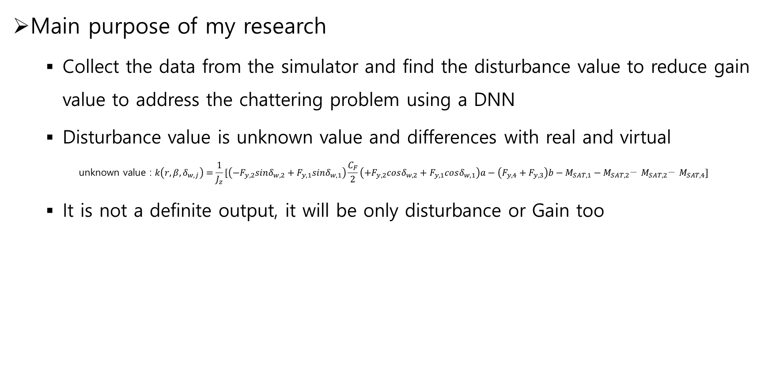
Torque Vectoring
Main purpose of my research
Collect the data from the simulator and find the disturbance value to reduce gain value to address the chattering problem using a DNN
Disturbance value is unknown value and differences with real and virtual
$$\text{unknown} \text{value}\text{ : }k\left(r,β,δ_{w,j}\right)=\frac{1}{J_{z}}[\left(−F_{y,2}sinδ_{w,2}+F_{y,1}sinδ_{w,1}\right)\frac{C_{F}}{2}\left(+F_{y,2}cosδ_{w,2}+F_{y,1}cosδ_{w,1}\right)a−\left(F_{y,4}+F_{y,3}\right)b−M_{SAT,1}−M_{SAT,2}\text{− }M_{SAT,2}\text{− }M_{SAT,4}]$$
It is not a definite output, it will be only disturbance or Gain too

Slide 14
Torque Vectoring
Research plan
Find the relation with variables and disturbance for select input data
Make DNN model as small as possible for MCU
The metrics for the model is the improvement of chattering problem
Experiment real world (if I can)
More advance DNN model added (if MCU can) because just DNN is not good at outlier

Slide 15
References
V. Utkin, J. Guldner, and J. Shi, Sliding Mode Control in Electromechanical Systems. New York, NY, USA: Taylor & Francis, 1999.
Goggia, Tommaso, et al. "Integral sliding mode for the torque-vectoring control of fully electric vehicles: Theoretical design and experimental assessment." IEEE Transactions on Vehicular Technology 64.5 (2014): 1701-1715.

Slide 16
Q&A

Slide 17
THANK YOU!

